Slide 1

ENGG404 Lecture Chapter 7.7: Safety Metrics, Lagging and Leading Indicators
Fundamentals of RM
RM System and Process
Leadership in RM
Incident Investigation
RM Tools & Challenges
RM in Industry
People & Org.
Application and Perspectives
On becoming a leader in risk management
1

Slide 2
Learning Outcomes:
Explain the difference between leading indicators and lagging indicators.
Explain how applying leading indicators can aid in prioritizing limited resources in managing risks.
Chapter 7.7: Safety Metrics – Leading and Lagging Indicators
2

Slide 3
Lagging Indicators – Examples:
The lagging indicator statistic is created as a result of a loss incident i.e. it is created and recorded after the fact:
# of first aid cases
Total recordable incident rate
Lost time incident rate
# of fatalities
# of incident investigations performed
Chapter 7.7: Safety Metrics – Leading and Lagging Indicators
3

Slide 4
Lagging Indicators – Problems and Limitations:
Problems and Limitations:
Even though these include both occupational safety and process safety, there tends to be an over-emphasis on occupational injuries
Not all are reported or investigated.
Negative trends can create “knee-jerk” reactions.
Positive trends are not appropriately resourced.
Cannot be used as a means to influence safety culture for effective and sustainable performance improvements.
Especially for process safety incidents, there may be long durations of “positive” performance between events; thus, “lulling” the organization into a false sense of “security” and the RM program is “invulnerable” or at least “robust”.
Chapter 7.7: Safety Metrics – Leading and Lagging Indicators
4

Slide 5
Leading Indicators – Examples:
In contrast, the leading indicator statistic is created as a result of a proactive planned inspection or audit that is intended to assess the effective implementation of the RM program and to prevent incidents from happening:
# of Job Safety Analysis documents reviewed
# of job observations and planned inspections carried out
# near miss incident reports received and reviewed
# near miss incident reports addressed
# of SC and SP reports received and reviewed
# of SC and SP reports addressed
# safe behavior awards presented to employees
# of safety systems disabled or bypassed
# of changes appropriately managed, RME #4 MOC
# of management safety audits completed, RME #6 PECI
# of inspections on safety equipment carried out, RME #8 O&M
# of employees with up-to-date qualifications, RME #9 EC&T
Chapter 7.7: Safety Metrics – Leading and Lagging Indicators
5

Slide 6
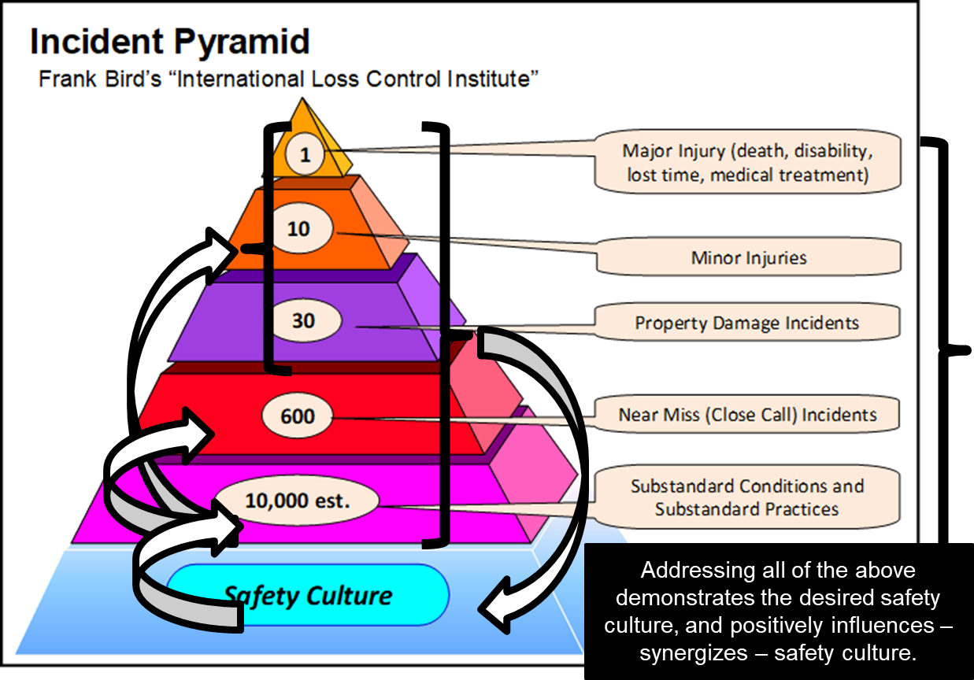
Leading Indicators – Benefits:
Can be directly used by leaders to influence the safety culture.
Chapter 7.7: Safety Metrics – Leading and Lagging Indicators
6

Slide 7
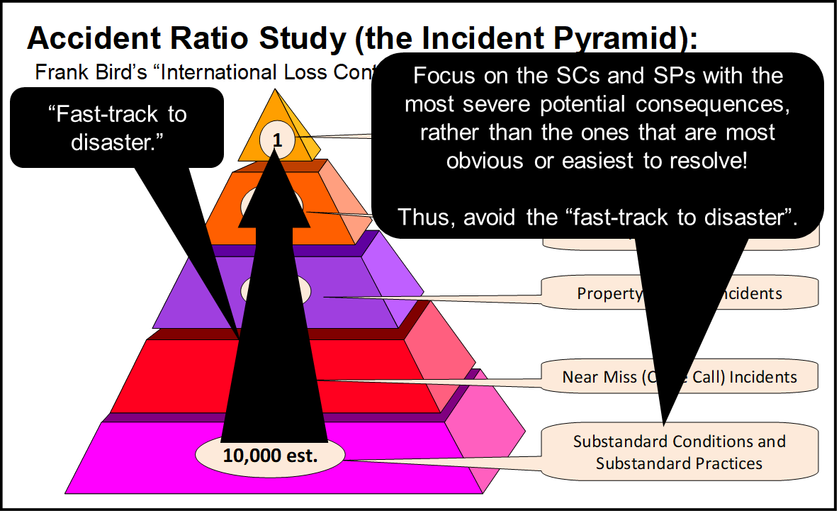
Leading Indicators – Benefits:
For process safety incidents, the implementation of the RM program is measured on an on-going basis using leading indicators, and action can be taken to address deficiencies before a loss incident occurs.
“Early signals” of sub-standard conditions and sub-standard practices where the risk level increases substantially can be used to inform leaders in the allocation of resources to address these; thus avoiding situations where “one small misstep” can lead to disaster.
Chapter 7.7: Safety Metrics – Leading and Lagging Indicators
7

Slide 8
Summary:
Leaders can use leading indicators to:
Measure the overall effective implementation of a risk management program.
Influence the culture of an organization.
Identify weaknesses in RM programs especially relating to process safety, and use these to prioritize and allocate limited resources to address deficiencies in activities with high risk levels.
Chapter 7.7: Safety Metrics – Leading and Lagging Indicators
8
Notes:
8

